Slide 1
In-context Learning
[Slide credit: Iz Beltagy, Arman Cohan, Robert Logan IV, Sewon Min, Sameer Singh, and many others ]
CSCI 601-471/671 (NLP: Self-Supervised Models)
https://self-supervised.cs.jhu.edu/sp2024/

Slide 2
Logistics
HW6: The Struggles … ☹
HW7 will be the last homework! ☺
Projects
Do you have an idea yet?
Do you have teammate(s) already?
Have you looked at the deck of ideas I shared yet?
Project proposal deadline: Thu Mar 16
Should we push it back? Alternative: Tue Mar 28

Slide 3
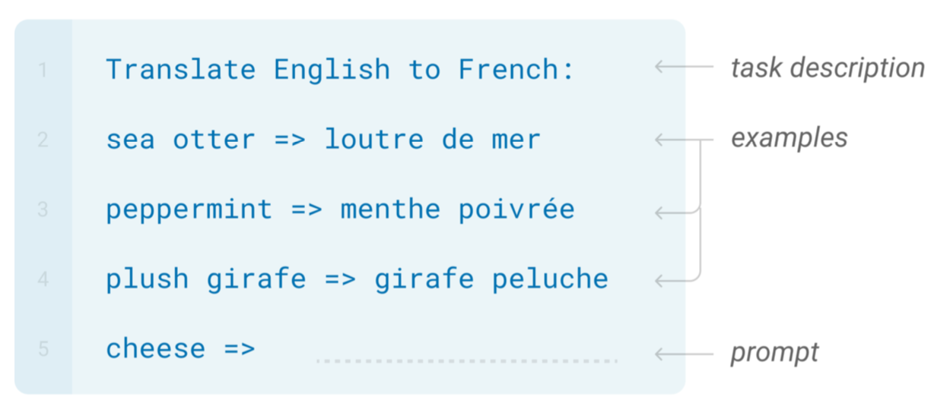
In-Context Learning

Slide 4
In-Context Learning
Learns to do a downstream task by conditioning on input-output examples!
No weight update — our model is not explicitly pre-trained to learn from examples
The underlying models are quite general
Today’s focus:
How to use effectively in practice?
Fundamentally, why does it work?

Slide 5
Why Do We Care About Few-Shot Learning?
Practically Useful
Intellectually Intriguing
[ACL 2022 Tutorial Beltagy, Cohan, Logan IV, Min and Singh]

Slide 6
Practically Useful
Labeling data is costly
May require domain expertise
Medical, legal, ﬁnancial
Inputs may be long/complex
Grammaticality
Outputs may be complex
Semantic parsing
[ACL 2022 Tutorial Beltagy, Cohan, Logan IV, Min and Singh; quote credit: Colin Raffel]

Slide 7
Practically Useful
Labeling data is costly
You want to do best with what you have
You don’t want to get more data
Emergent, time-sensitive scenarios
Something new happened
Need to react quickly!
[ACL 2022 Tutorial Beltagy, Cohan, Logan IV, Min and Singh]

Slide 8
Practically Useful
Labeling data is costly
You want to do best with what you have
Training is sensitive to hyperparams
Not enough validation data
We don’t quite understand how finetuning works
Finetuning can unstable
[ACL 2022 Tutorial Beltagy, Cohan, Logan IV, Min and Singh]

Slide 9
Practically Useful
Labeling data is costly
You want to do best with what you have Finetuning can be unstable
Finetuning large LMs is expensive
Expensive to train, time and memory
[ACL 2022 Tutorial Beltagy, Cohan, Logan IV, Min and Singh]

Slide 10
Intellectually Intriguing
Potential test for “Intelligent Behavior”
Generalization from few examples
Fundamental piece of intelligence
Often used in psychology
Quickly adjust to environment
[ACL 2022 Tutorial Beltagy, Cohan, Logan IV, Min and Singh]

Slide 11
Intellectually Intriguing
Potential test for “Intelligent Behavior”
“But… Deep learning is data hungry!”
Long-standing criticism of DL
Understand why it doesn’t work here
Or does it?
What are the new limitations of DL?
[ACL 2022 Tutorial Beltagy, Cohan, Logan IV, Min and Singh]

Slide 12
Intellectually Intriguing
Potential test for “Intelligent Behavior”
“But… Deep learning is data hungry!”
What does an LLM “know”?
What are the biases/limitations of LLMs?
…
Insights into Language Modeling
[ACL 2022 Tutorial Beltagy, Cohan, Logan IV, Min and Singh]

Slide 13
Intellectually Intriguing
Potential test for “Intelligent Behavior”
“But… Deep learning is data hungry!” Insights into Language Modeling
Training/inference/access is tough
What else can we do? ;)
Because LARGE language models
[ACL 2022 Tutorial Beltagy, Cohan, Logan IV, Min and Singh]

Slide 14
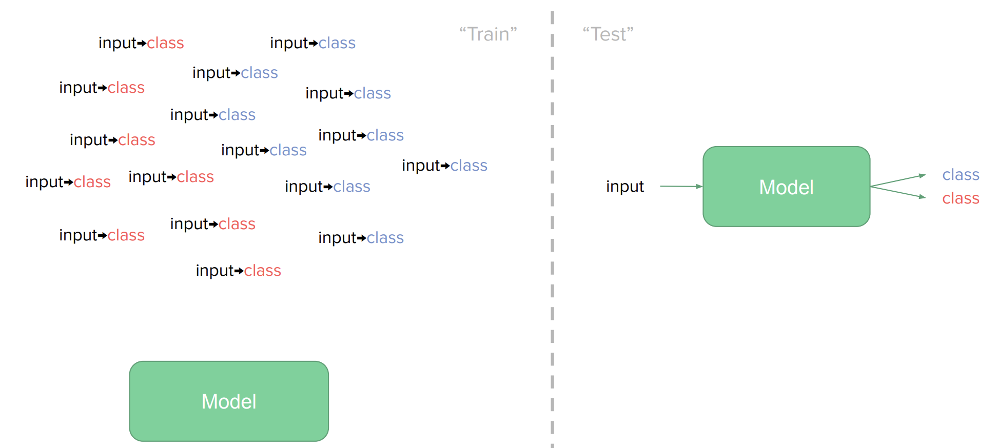
The Broader Context: Supervised Learning
[ACL 2022 Tutorial Beltagy, Cohan, Logan IV, Min and Singh]

Slide 15
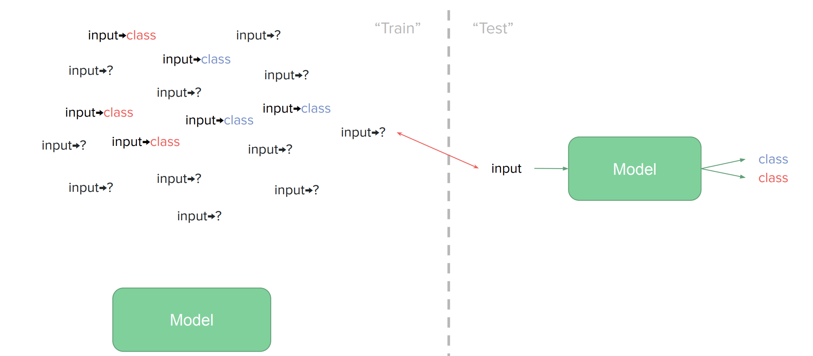
The Broader Context: Semi-Supervised Learning
[ACL 2022 Tutorial Beltagy, Cohan, Logan IV, Min and Singh]

Slide 16
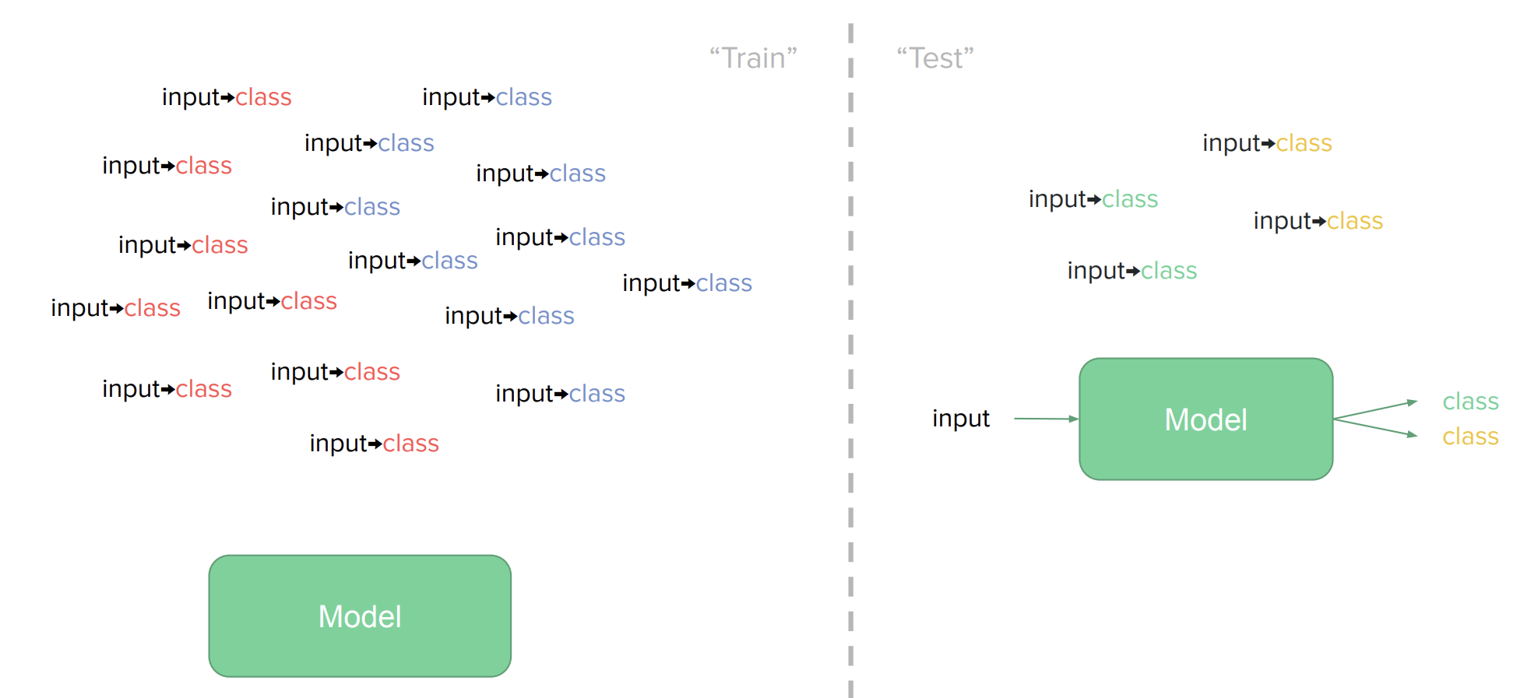
The Broader Context: [Traditional] Few-shot Learning
[ACL 2022 Tutorial Beltagy, Cohan, Logan IV, Min and Singh]

Slide 17
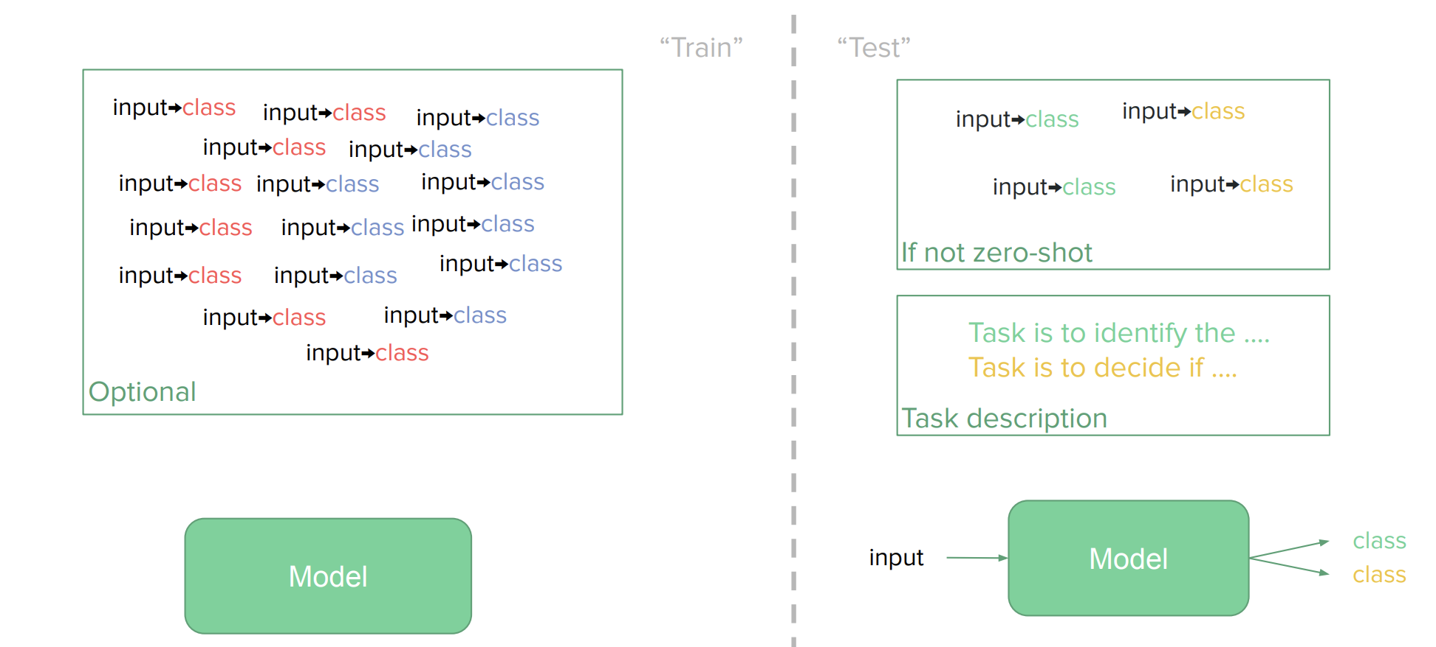
The Broader Context: [Modern] Few-shot Learning
[ACL 2022 Tutorial Beltagy, Cohan, Logan IV, Min and Singh]

Slide 18
In-Context Prompting
Movie review dataset
Input: An effortlessly accomplished and richly resonant work.
Label: positive
Input: A mostly tired retread of several other mob tales.
Label: negative
An effortlessly accomplished and richly resonant work. It was great! A mostly tired retread of several other mob tales. It was terrible!
A three-hour cinema master class. It was
Language Model
p1 = P(It was great! | 1st train input+output \n 2nd train input+output \n A three-hour cinema master class.)
p2 = P(It was terrible! | 1st train input+output \n 2nd train input+output \n A three-hour cinema master class.)
p1>p2
p1<p2
“positive” “negative”
[ACL 2022 Tutorial Beltagy, Cohan, Logan IV, Min and Singh]

Slide 19
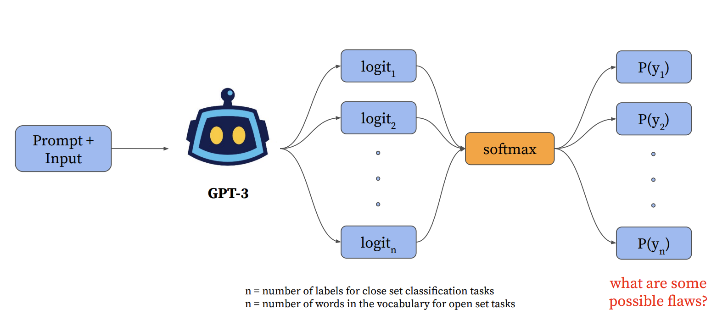
LM Prompting
[Slide credit: Howard Yen, Vishvak Murahari]

Slide 20
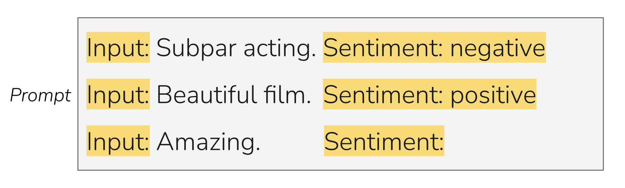
LM Prompting: Choices of Encoding
[Slide credit: Eric Wallace]

Slide 21
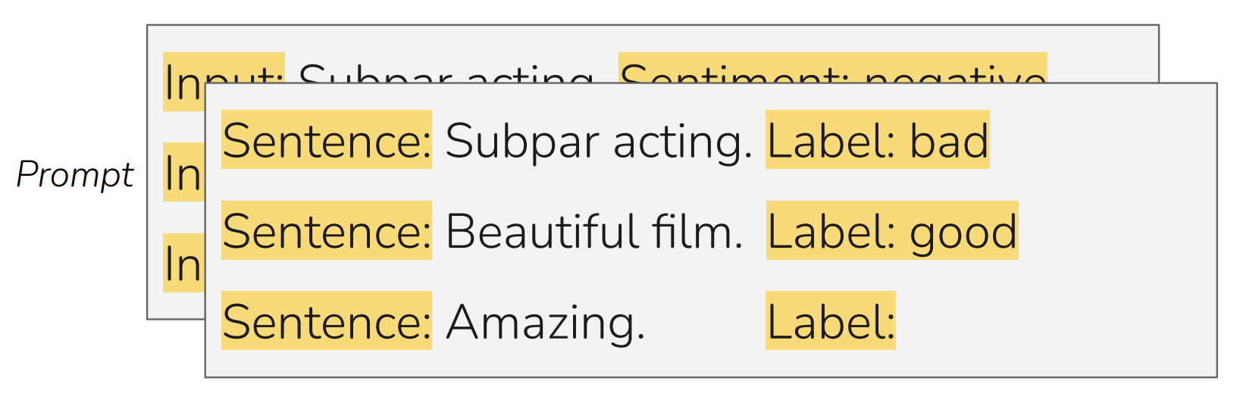
LM Prompting: Choices of Encoding
[Slide credit: Eric Wallace]

Slide 22
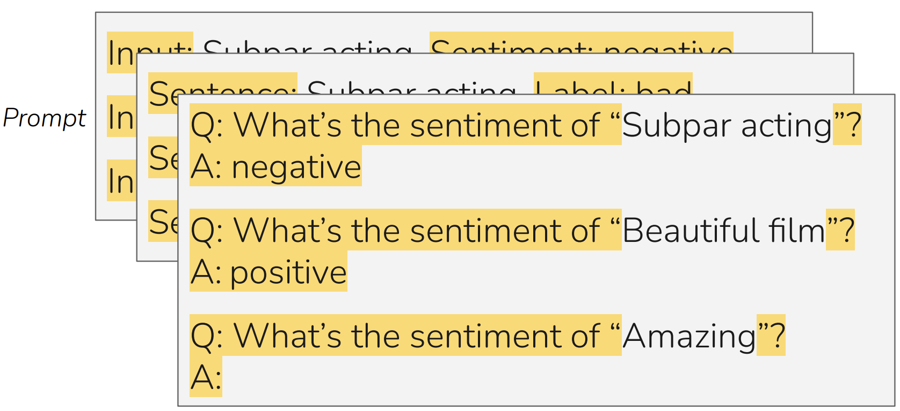
LM Prompting: Choices of Encoding
[Slide credit: Eric Wallace]

Slide 23
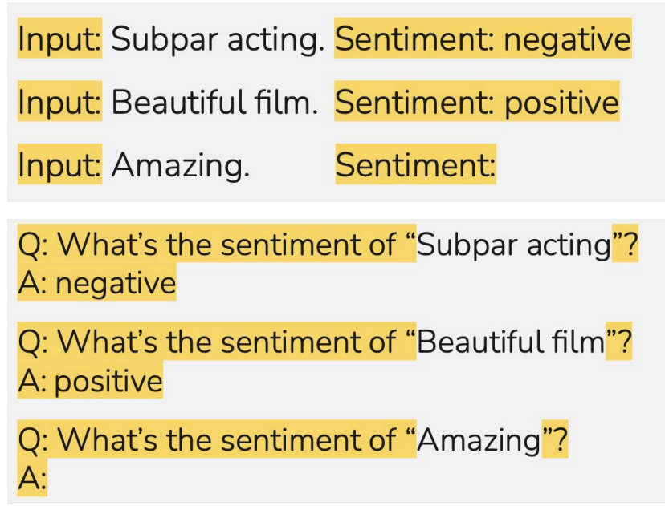
LM Prompting: Choices of Encoding
Pattern: A function that encodes the inputs.
Verbalizer: A function that encodes the output.
Pattern: f(<x>) = “Input: <x>"
Verbalizer: v(<x>)) = “Label: <x>)”
Pattern: f(<x>) = “Q: What is the sentiment of <x>”
Verbalizer: v(<x>) = “A: <x>”
[Slide credit: Eric Wallace]

Slide 24
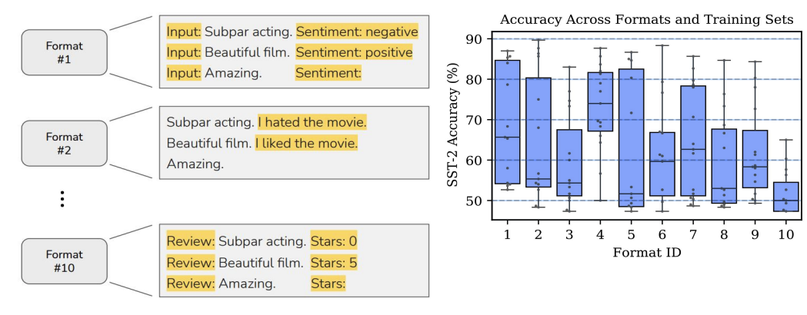
In-Context Learning: Sensitivity to Encoding
[Slide credit: Eric Wallace]
In-context learning is highly sensitive to prompt format (training sets and patterns/verbalizers)
[“Calibrate Before Use: Improving Few-Shot Performance of Language Models.” Zhao et al. 2021]

Slide 25
In-Context Learning: Sensitivity to Demo. Permutations
[Slide credit: Eric Wallace]
Training Set #1

Slide 26
In-Context Learning: Sensitivity to Demo. Permutations
[Slide credit: Eric Wallace]
Example #1
Example #2
Example #3
Example #4
Training Set #1

Slide 27
In-Context Learning: Sensitivity to Demo. Permutations
[Slide credit: Eric Wallace]
Example #1
Example #2
Example #3
Example #4
Example #2
Example #1
Example #3
Example #4
Example #4
Example #3
Example #2
Example #1
...
Prompt #1
Prompt #2
Prompt #24
All 24 Permutations
Example #1
Example #2
Example #3
Example #4
Training Set #1

Slide 28
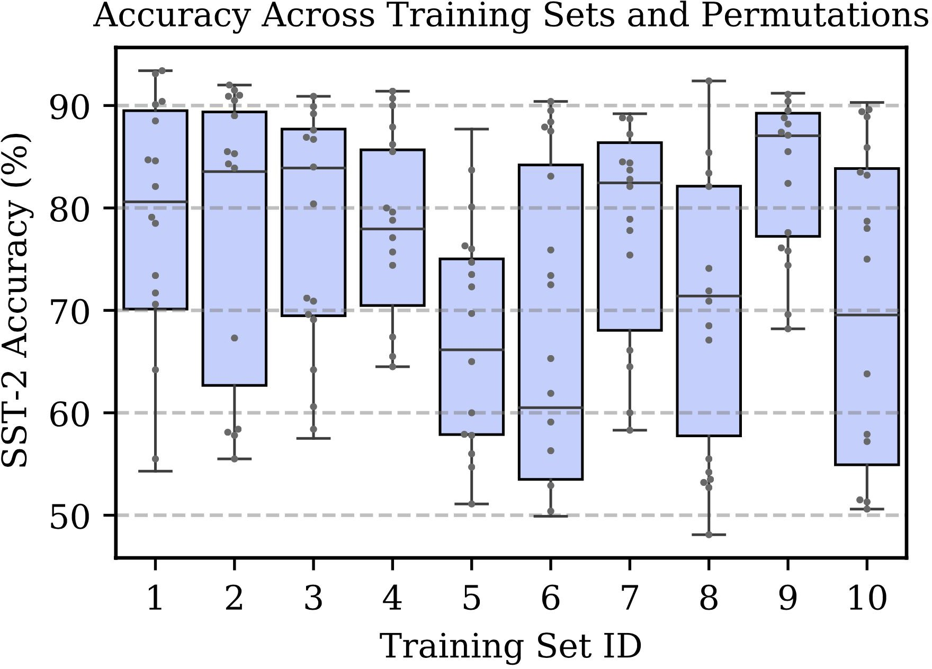
In-Context Learning: Sensitivity to Demo. Permutations
[Slide credit: Eric Wallace]
Example #1
Example #2
Example #3
Example #4
Example #2
Example #1
Example #3
Example #4
Example #4
Example #3
Example #2
Example #1
...
Prompt #1
Prompt #2
Prompt #24
All 24 Permutations
Example #1
Example #2
Example #3
Example #4
In-context learning is highly sensitive to prompt format (training sets and patterns/verbalizers)
Training Set #1
[“Calibrate Before Use: Improving Few-Shot Performance of Language Models.” Zhao et al. 2021]

Slide 29
In-Context Learning: Sensitivity to Demo. Permutations
[Slide credit: Eric Wallace]
Example #1
Example #2
Example #3
Example #4
Example #2
Example #1
Example #3
Example #4
Example #4
Example #3
Example #2
Example #1
...
Prompt #1
Prompt #2
Prompt #24
All 24 Permutations
Example #1
Example #2
Example #3
Example #4
Training Set #1
Training Set #2
[“Calibrate Before Use: Improving Few-Shot Performance of Language Models.” Zhao et al. 2021]

Slide 30
In-Context Learning: Sensitivity to Demo. Permutations
[Slide credit: Eric Wallace]
Example #1
Example #2
Example #3
Example #4
Example #2
Example #1
Example #3
Example #4
Example #4
Example #3
Example #2
Example #1
...
Prompt #1
Prompt #2
Prompt #24
All 24 Permutations
Example #1
Example #2
Example #3
Example #4
The choice of demonstrations and their order is quite important.
Training Set #1
Training Set #2
...
Training Set #10
[“Calibrate Before Use: Improving Few-Shot Performance of Language Models.” Zhao et al. 2021]

Slide 31
Sensitivity to Wording (Framing) of Prompts
Framing of prompts matters a lot.
Craft a question that requires commonsense to be answered. Based on the given context, craft a common-sense question, especially those that are LONG, INTERESTING, and COMPLEX. The goal is to write questions that are easy for humans and hard for AI machines! To create such questions, here are some suggestions: A. What may (or may not) be the plausible reason for an event? B. What may (or may not) happen before (or after, or during) an event? ...
Generate questions such that you use - ‘what may happen’, - ‘will ...?’, - ‘why might’, - ‘what may have caused’, - ‘what may be true about’,
- ‘what is probably true about’, - ‘what must’ and similar phrases in your question based on the input context.
[“Reframing Instructional Prompts to GPTk's Language.” Mishra et al. 2021.]

Slide 32
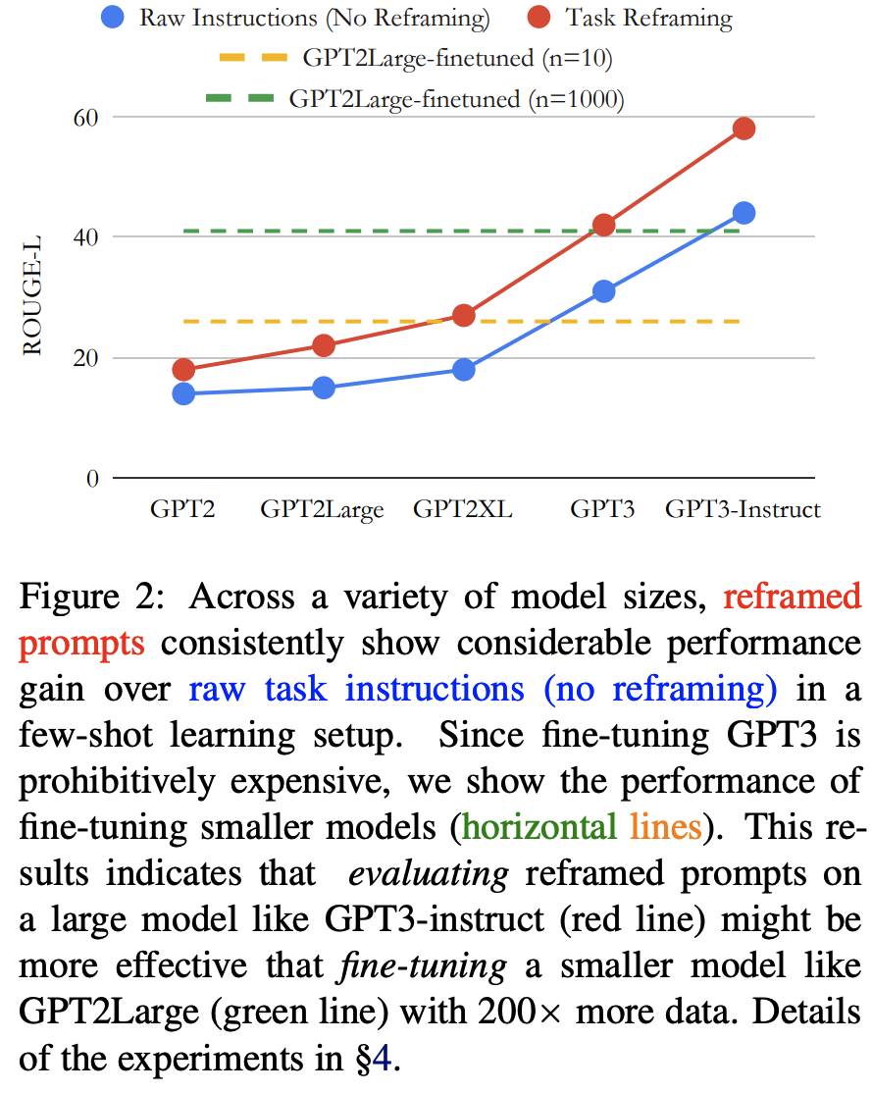
Sensitivity to Wording (Framing) of Prompts
Prompts can often be phrased in a language that are easier to be understood by language models.
Generally, it is easier for LMs to follow shorter, crisp, itemized prompts.
[“Reframing Instructional Prompts to GPTk's Language.” Mishra et al. 2021.]

Slide 33
Summary Thus Far
There are many possible ways to encode in-context examples of a fixed task
Many possible patterns/verbalizers
The choice of demonstrations
Ordering of the examples
….
It turns out there is a huge variance in performance depending on the encoding.
You can treat them as hyper-parameters
You should not choose these encodings based on the test data.
Generally, it is better to use encoding that makes the sequence closer to language modeling — closer to what is observed during pretraining.

Slide 34
What Causes These Variances?
Here we will provide several justifications …

Slide 35
Majority Label Bias

Slide 36
Majority Label Bias
Frequency of Positive Predictions
4/4
Positive
3/4
Positive
2/4
Positive
1/4
Positive
0/4
Positive
[“Calibrate Before Use: Improving Few-Shot Performance of Language Models.” Zhao et al. 2021]

Slide 37
Majority Label Bias
Frequency of Positive Predictions
100
56
37
20
0
4/4
Positive
3/4
Positive
2/4
Positive
1/4
Positive
0/4
Positive
[“Calibrate Before Use: Improving Few-Shot Performance of Language Models.” Zhao et al. 2021]

Slide 38
Majority Label Bias
Frequency of Positive Predictions
100
56
37
20
0
4/4
Positive
3/4
Positive
2/4
Positive
1/4
Positive
0/4
Positive
Majority label bias: frequent training answers dominate predictions
Explain some of the variances across example selections

Slide 39
Recency Bias

Slide 40
Recency Bias
Frequency of Positive Predictions
NPPP
PNPP
PPNP
PPPN

Slide 41
Recency Bias
Frequency of Positive Predictions
90
62
60
12
NPPP
PNPP
PPNP
PPPN
[“Calibrate Before Use: Improving Few-Shot Performance of Language Models.” Zhao et al. 2021]

Slide 42
Recency Bias
Frequency of Positive Predictions
90
62
60
12
NPPP
PNPP
PPNP
PPPN
Recency bias: examples near end of prompt dominate predictions
Explains variance across example permutations

Slide 43
Common Token Bias

Slide 44
Common Token Bias
Language Model
What topic is the following text about?
The Model T was released by Ford in 1908. Answer:
Prompt

Slide 45
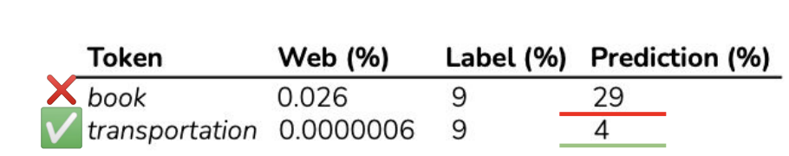
Common Token Bias
Token
Prob
Language Model
book | 0.35
transportation | 0.23
school | 0.11
village | 0.03
company | 0.02
What topic is the following text about?
The Model T was released by Ford in 1908. Answer:
Prompt
Model is biased towards predicting the incorrect frequent token "book" even when both "book" and "transportation" are equally likely labels in the dataset
Common token bias: common n-grams dominate predictions
helps explain variance across prompt formats

Slide 46
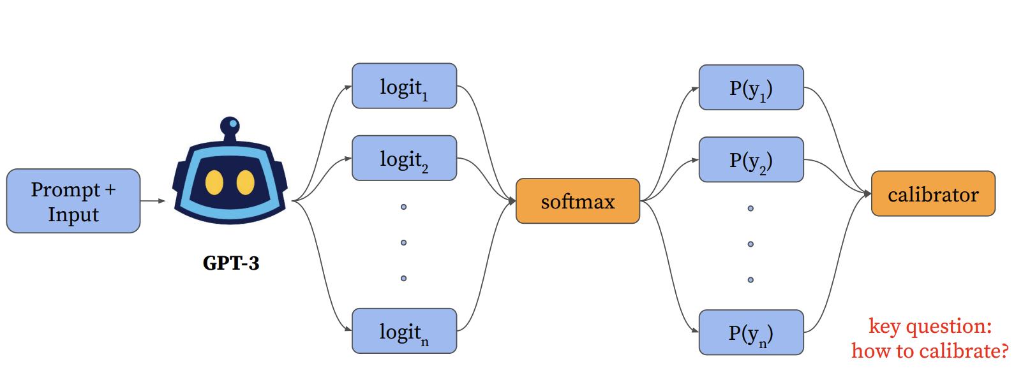
Calibrating LM Probabilities
[Slide credit: Howard Yen, Vishvak Murahari]

Slide 47
Calibrating LM Probabilities
Step 1: Estimate the bias

Slide 48
Calibrating LM Probabilities
Step 1: Estimate the bias
Insert “content-free” test input into prompt
Input: Subpar acting. Sentiment: negative Input: Beautiful ﬁlm. Sentiment: positive Input: Sentiment:
N/A

Slide 49
Calibrating LM Probabilities
Step 1: Estimate the bias
Insert “content-free” test input into prompt
Input: Subpar acting. Sentiment: negative Input: Beautiful ﬁlm. Sentiment: positive Input: Sentiment:
N/A
Get model’s prediction
positive | 0.65
negative | 0.35

Slide 50
Calibrating LM Probabilities
Step 1: Estimate the bias Step 2: Counter the bias
Insert “content-free” test input into prompt
Input: Subpar acting. Sentiment: negative Input: Beautiful ﬁlm. Sentiment: positive Input: Sentiment:
N/A
Get model’s prediction
positive | 0.65
negative | 0.35

Slide 51
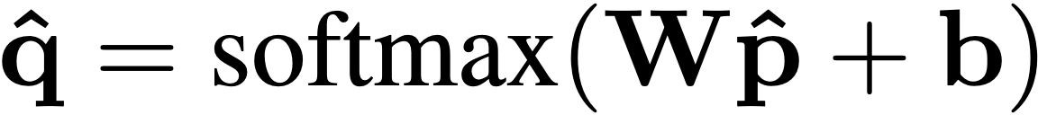
Calibrating LM Probabilities
Step 1: Estimate the bias Step 2: Counter the bias
(“Platt Scaling”)
Insert “content-free” test input into prompt
“Calibrate” predictions with afﬁne transformation
Input: Subpar acting. Sentiment: negative Input: Beautiful ﬁlm. Sentiment: positive Input: Sentiment:
N/A
Get model’s prediction
positive | 0.65
negative | 0.35
[“Calibrate Before Use: Improving Few-Shot Performance of Language Models.” Zhao et al. 2021]

Slide 52
Calibrating LM Probabilities
Step 1: Estimate the bias Step 2: Counter the bias
(“Platt Scaling”)
Insert “content-free” test input into prompt
“Calibrate” predictions with afﬁne transformation
Input: Subpar acting. Sentiment: negative Input: Beautiful ﬁlm. Sentiment: positive Input: Sentiment:
N/A
Calibrated probs
Original probs
Get model’s prediction
positive | 0.65
negative | 0.35
[“Calibrate Before Use: Improving Few-Shot Performance of Language Models.” Zhao et al. 2021]

Slide 53

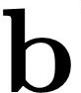
Calibrating LM Probabilities
Step 1: Estimate the bias Step 2: Counter the bias
(“Platt Scaling”)
Insert “content-free” test input into prompt
“Calibrate” predictions with afﬁne transformation
Input: Subpar acting. Sentiment: negative Input: Beautiful ﬁlm. Sentiment: positive Input: Sentiment:
N/A
Calibrated probs
Original probs
Fit and to so that outputs for the content-free input are uniform
Get model’s prediction
positive | 0.65
negative | 0.35
[“Calibrate Before Use: Improving Few-Shot Performance of Language Models.” Zhao et al. 2021]

Slide 54
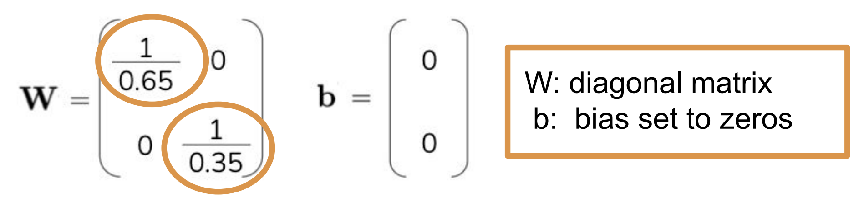
Calibrating LM Probabilities
Step 1: Estimate the bias Step 2: Counter the bias
(“Platt Scaling”)
Note, this calibration does not require any labeled data.
Classification tasks: normalized scores of labels
Generation tasks: probabilities of the first token of the generation over the entire vocabulary
Insert “content-free” test input into prompt
“Calibrate” predictions with afﬁne transformation
Input: Subpar acting. Sentiment: negative Input: Beautiful ﬁlm. Sentiment: positive Input: Sentiment:
N/A
Calibrated probs
Original probs
Fit and to so that outputs for the content-free input are uniform
Get model’s prediction
positive | 0.65
negative | 0.35
[“Calibrate Before Use: Improving Few-Shot Performance of Language Models.” Zhao et al. 2021]

Slide 55
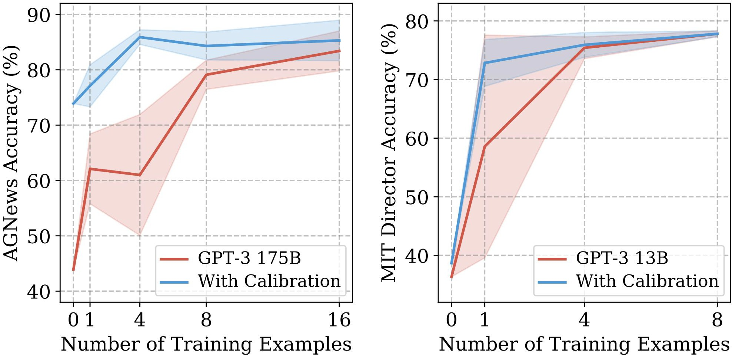
Effect of Calibration
Improves mean and worst-case accuracy
Reduces variance across training sets and permutations

Slide 56
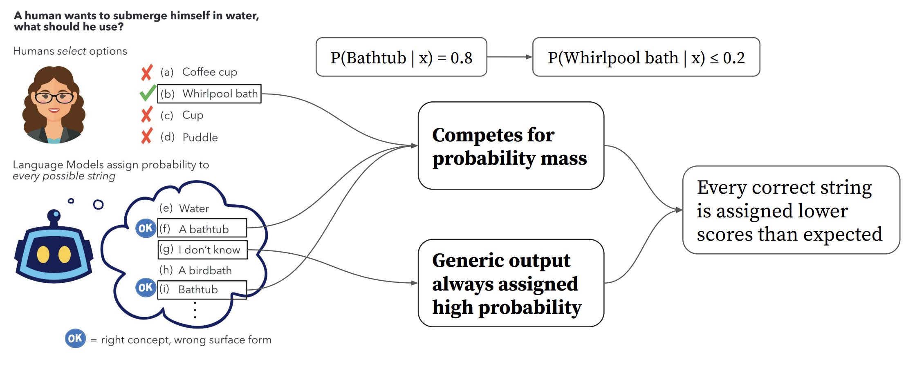

Surface Form Competition
Surface forms are competing for probability mass — skew the probabilities.
There are some ideas on how to calibrate for these issues (see Holtzman et al 2021).
[Slide credit: Howard Yen, Vishvak Murahari]

Slide 57
Summary Thus Far
61
LM prompting & In-context learning show promising results, but their performance is highly unstable/brittle.
Better scoring: Calibration
Other factors:
Better formation of demonstrations
Better choice of demonstrative examples
Better ordering of demonstrative examples
[ACL 2022 Tutorial Beltagy, Cohan, Logan IV, Min and Singh]

Slide 58


How/Why does In-context Learning Work?
63
Any arbitrary task
Language Model
A few-shot learner
[ACL 2022 Tutorial Beltagy, Cohan, Logan IV, Min and Singh]

Slide 59
How/Why does In-context Learning Work?
64
Any arbitrary task
Language Model
A few-shot learner
[ACL 2022 Tutorial Beltagy, Cohan, Logan IV, Min and Singh]

Slide 60
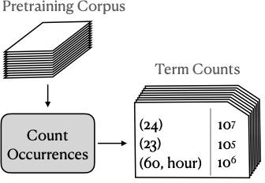
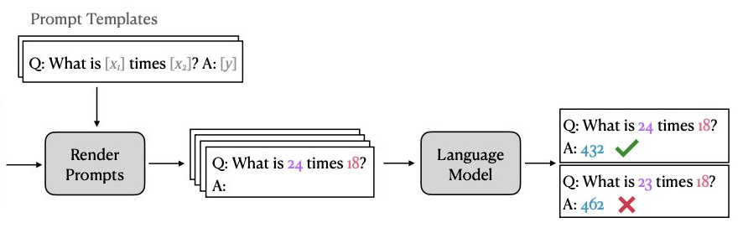
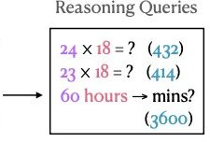
Impact of Pretraining Term Frequencies
67
For each task, identify relevant terms from each instance—numbers and units
Count co-occurrences of these terms in the pretraining data (term pairs or triples within a ﬁxed window)
["Impact of Pretraining Term Frequencies on Few-Shot Reasoning" Razeghi et al. 2022.]

Slide 61
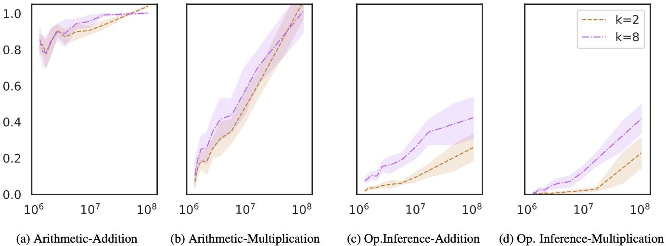
Impact of Pretraining Term Frequencies
This may also indicate that, demonstrations do not teach a new task; instead, it is about locating an already-learned task during pretraining (Reynolds & McDonell, 2021)
But that brings up the question of how much LMs actually reason when solving these tasks.🤔 Overlooking the impact of pretraining data can be misleading in evaluation!
In-context learning performance is highly correlated with
term frequencies during pretraining
["Impact of Pretraining Term Frequencies on Few-Shot Reasoning" Razeghi et al. 2022.]

Slide 62
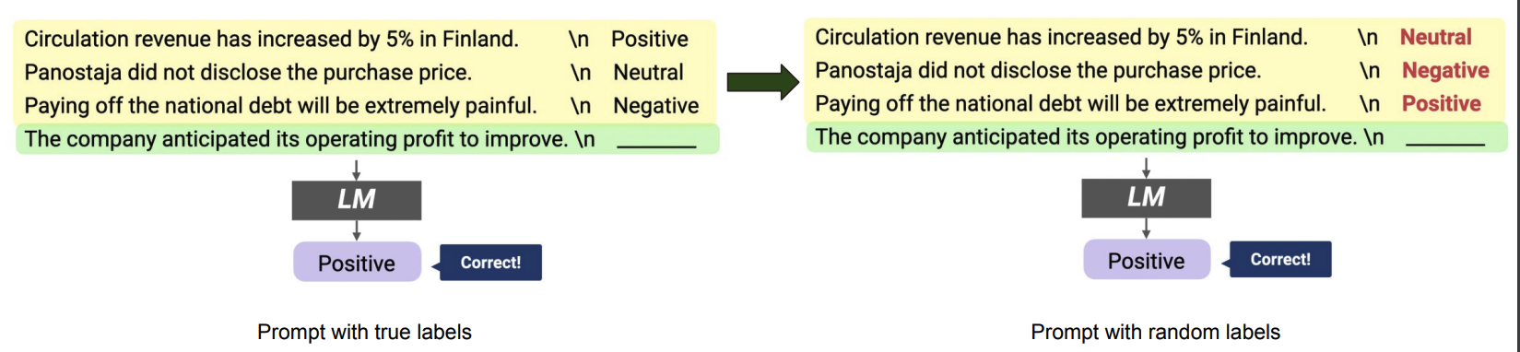
Impact of Input-Output Mapping
Study the effect of randomizing labels in demonstrations.
Randomly sample a label from the correct label space
["Rethinking the Role of Demonstrations: What Makes In-Context Learning Work?" Min et al. 2022.]

Slide 63
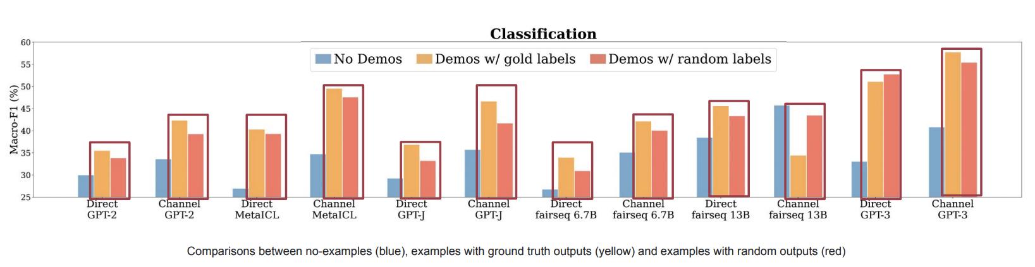
Impact of Input-Output Mapping
Models see a small performance drop (0–5% absolute) with random labels
Takeaway: ground truth input-label mapping in the prompt is not as important as we thought
["Rethinking the Role of Demonstrations: What Makes In-Context Learning Work?" Min et al. 2022.]

Slide 64
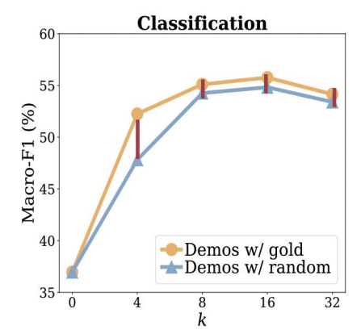
Impact of Input-Output Mapping
Vary number of demonstrations
Takeaway:
Performance drop from using gold labels to using random labels is consistently small across varying k, ranging from 0.8–1.6%
Using small number of examples with random labels is better than no examples
["Rethinking the Role of Demonstrations: What Makes In-Context Learning Work?" Min et al. 2022.]

Slide 65
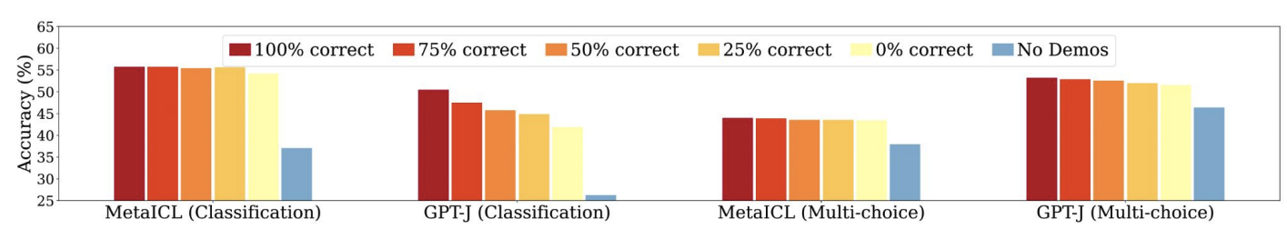
Impact of Input-Output Mapping
Vary the size of the noisy demonstrations
Takeaway: Using all incorrect labels preserves 97% of improvements from using all correct labels
["Rethinking the Role of Demonstrations: What Makes In-Context Learning Work?" Min et al. 2022.]

Slide 66
In-context Learning
CSCI 601 471/671
NLP: Self-Supervised Models
https://self-supervised.cs.jhu.edu/sp2023/
[Slide credit: Iz Beltagy, Arman Cohan, Robert Logan IV, Sewon Min, Sameer Singh, and many others ]

Slide 67
In-Context Learning
Learns to do a downstream task by conditioning on input-output examples!
No weight update — our model is not explicitly pre-trained to learn from examples
The underlying models are quite general
Today’s focus:
How to use effectively in practice?
Fundamentally, why does it work?

Slide 68
How/Why does In-context Learning Work?
64
Any arbitrary task
Language Model
A few-shot learner
[ACL 2022 Tutorial Beltagy, Cohan, Logan IV, Min and Singh]

Slide 69
In-context Learning as Bayesian Inference
(Xie et al., 2022) try to explain ICL as an implicit Bayesian inference.
Idea:
(Pre-trained LM learn to represent “concepts”, i.e. the ideas described by words.
ICL enables LMs to “locate” the learned concepts.
Can formulate this intuition as a Bayesian inference
Prior over latent “concepts”
Likelihood describes connection between text and concepts
Given an incomplete doc, use Bayes formula to infer what concept is likely it is generated from and then complete the document.
Does not explain everything.
GPT-3 can handle “unseen” concepts
$c_{1}$ $c_{2}$
latent concepts
observed documents
(e.g., demonstrations)
$d_{1}$ $d_{2}$ $d_{3}$

Slide 70
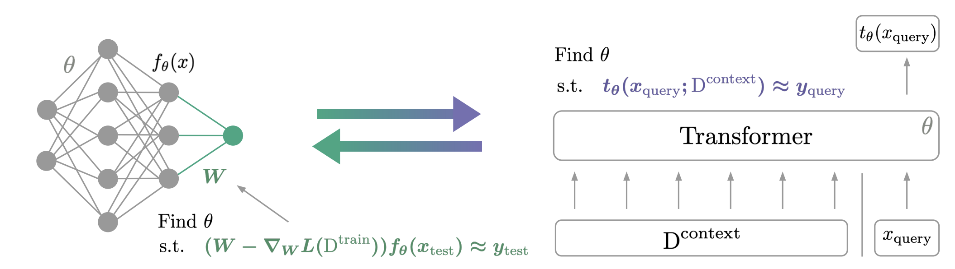
In-context Learning as Gradience Descent
65
ICL is implicitly equivalent to SGD on in-context demonstrations
[von Oswald et al. 2022; Akyurek et al. 2022; Dai et al. 2022, …]

Slide 71
Summary & Open questions
75
In-context learning has been a promising few-shot learning approach
No need for gradient updates → Much easier to use large models!
Better calibration, better scoring of model outputs, and better formation of demonstrations lead to great improvements
How to make it less sensitive?
How to scale it (longer context, more training examples, wider range of tasks)?
Still in progress …
Understanding how/why it works,
Disentangling looking up task location vs learning a new task
Can we predict whether in-context learning would work on a given task or not?

Slide 72
Prompting for Multi-Step Reasoning

Slide 73
Some Problems Involve Reasoning
Q: If there are 3 cars in the parking lot and 2 more cars arrive, how many cars are in the parking lot?
Q: Take the last letters of the words in "Elon Musk" and concatenate them
Q: What home entertainment equipment requires cable?
Answer Choices: (a) radio shack
(b) substation (c) television (d) cabinet
A: The answer is nk.
A: The answer is 5
A: The answer is (c).
Arithmetic Reasoning (AR)
(+ − ×÷…)
Symbolic Reasoning (SR)
Commonsense Reasoning (CR)

Slide 74
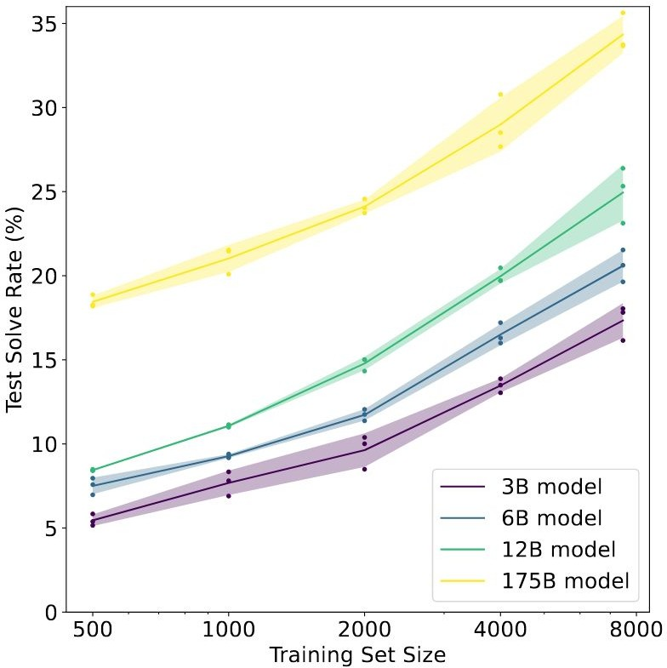
Reasoning Problems
(Cobbe et al. 2021)
Fine-tune LMs on GSM8K (arithmetic reasoning)
One may conjecture that, to achieve >80%, one needs 100x more training data for 175B model
Another option is to increase model sizes, which is expensive.
Other than these, how else can we improve the model performance on tasks that require multi-step reasoning?

Slide 75
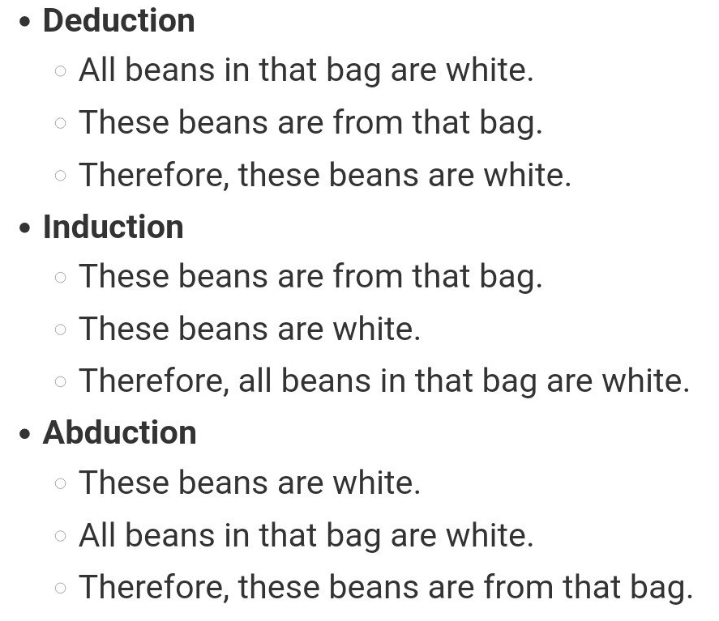
Reasoning Problems via Multi-Step Prompting
Basic idea: Rather than showing input-output pairs, prompting the model such that it shows its proof steps.
Note: ideas around models that are capable of multi-step reasoning go way back.
Aristotle (deduction),
Hume (induction),
Peirce (abduction)
Lots of other works in pre-LM era
Namely, my Ph.D. thesis ☺ on multi-step reasoning in semantic representations of language
[Reasoning-Driven Question-Answering for Natural Language Understanding]

Slide 76
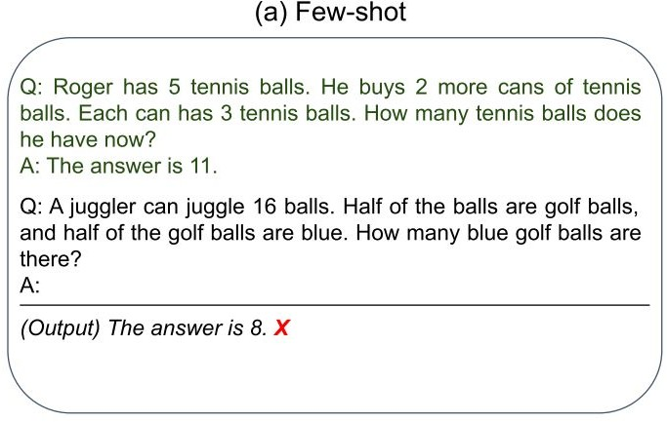
Reasoning Problems via Multi-Step Prompting

Slide 77
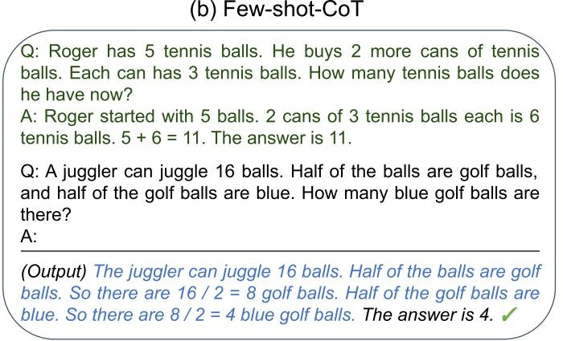
Reasoning Problems via Multi-Step Prompting
（Wei et al., 2022）
Step-by-step demonstration
Step-by-step Answer

Slide 78
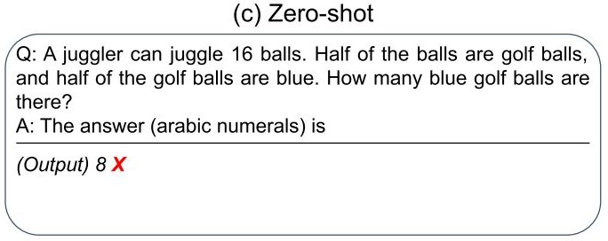
Reasoning Problems via Multi-Step Prompting
（Wei et al., 2022）
Step-by-step demonstration
Step-by-step Answer

Slide 79
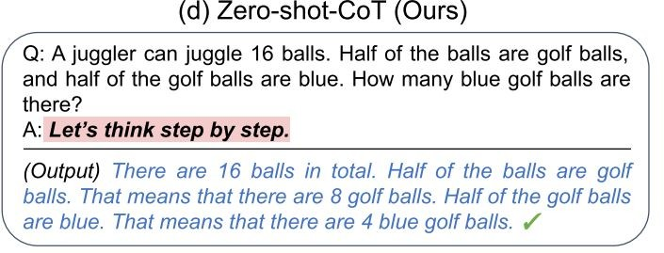
Reasoning Problems via Multi-Step Prompting
（Wei et al., 2022）
Step-by-step demonstration
Step-by-step Answer
（KoJima et al., 2022）
Two-stage Prompting Step-by-step Answer

Slide 80
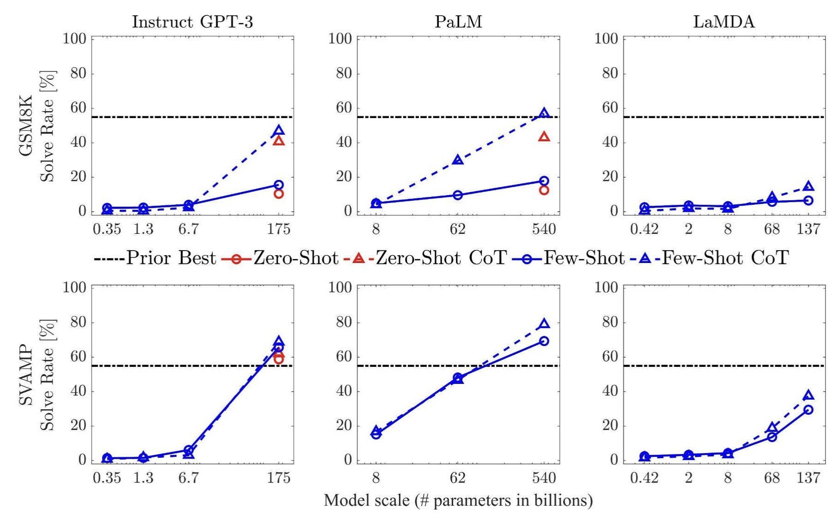
Multi-Step Prompting: Empirical Results
Setup: show demonstrations that contain the decompositions
The gains of multi-step prompting increases with scale.
Prompting achieves better perf than [smaller] models that are fine-tuned on a lot more data.
[“Chain of thought prompting elicits reasoning in large language models”, Wei et al. 2022]

Slide 81
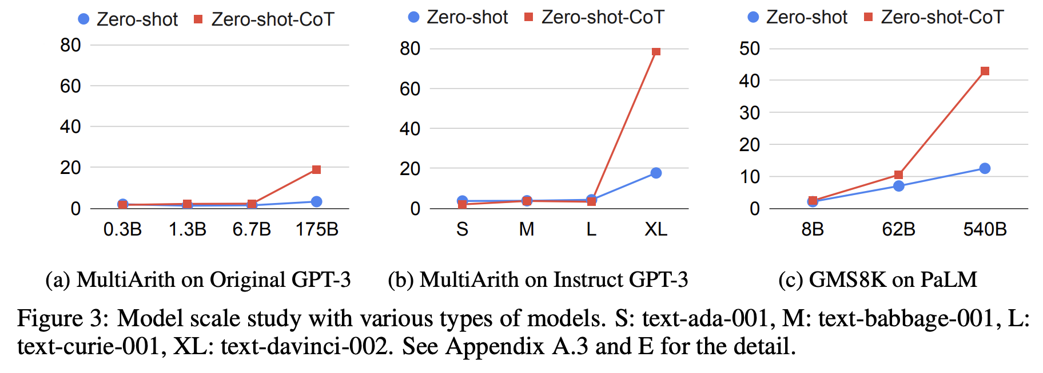
Multi-Step Prompting: Empirical Results
Setup: show demonstrations that contain the decompositions
The gains of multi-step prompting increases with scale.
Prompting achieves better perf than [smaller] models that are fine-tuned on a lot more data.
[“Large Language Models are Zero-Shot Reasoners”, Kojima et al. 2022]

Slide 82
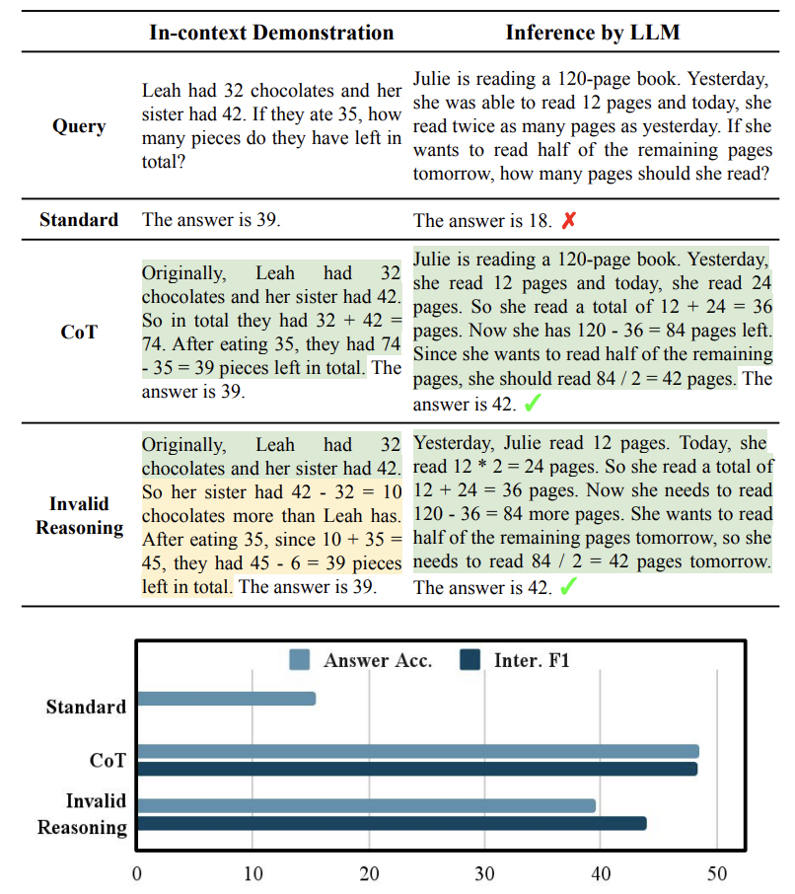
Multi-Step Prompting: Steps Don’t Have to Be Correct!
It is possible even with invalid demonstrations
Prompting with invalid reasoning steps can achieve over 80-90% of the performance with correct reasoning steps.
[“Towards Understanding Chain-of-Thought Prompting”, Wang et al. 2022]

Slide 83
ROSCOE: A Suite of Metrics for Scoring Step-by-Step Reasoning https://twitter.com/srush_nlp/status/1629229927898677252

Slide 84
Multi-Step Prompting: Parting Comments
Prompting LMs to explain their reasoning improves their performance.
However, their steps aren’t always correct.
A useful repository of annotation: https://github.com/OpenBioLink/ThoughtSource
There is much to research on here:
When do LMs over-reason or under-reason?
How do adjust the granularity of step?
How to use use given references in the proofs?
How do use external “tools” (e.g., logic, calculator, Python) in forming proofs?

Slide 85
Summary
Prompting language models is a powerful way to adapt them to our desired tasks.
They also serve as a gateway to understand the underlying dynamics inside models.
Lots of activity in this area and room for a lot of research progress.

Slide 86
Parameter-Efficient Tuning of LMs
CSCI 601 471/671
NLP: Self-Supervised Models
https://self-supervised.cs.jhu.edu/sp2023/
[Slide credit: Iz Beltagy, Arman Cohan, Robert Logan IV, Sewon Min, Sameer Singh, Danqi Chen and many others ]

Slide 87
Fine-tuning Pre-trained Models
81
Classiﬁcation
Head
A general recipe:
Pre-train a language model
Fine-tune a classification head on top of the LMs representations
Positive
Negative
Language
Model
Embeddings
Input
[CLS] A three-hour cinema master class.
[ACL 2022 Tutorial Beltagy, Cohan, Logan IV, Min and Singh]

Slide 88
Fine-tuning Pre-trained Models
82
Classiﬁcation
Head
Default ﬁnetuning recommendations are unstable in few-shot settings.
Positive
Negative
Stability can be improved by:
Using smaller learning rates
Training for more iterations
…
Language
Model
However ﬁnetuning still underperforms other methods.
Embeddings
Input
[CLS] A three-hour cinema master class.
["Fine-Tuning Pretrained Language Models: Weight Initializations, Data Orders, and Early Stopping" Dodge et al., 2020]
["On the Stability of Fine-tuning BERT: Misconceptions, Explanations, and Strong Baselines” Mosbach et al., 2020.]
[“Revisiting Few-sample BERT Fine-tuning” Zhang et al., 2020]
[ACL 2022 Tutorial Beltagy, Cohan, Logan IV, Min and Singh]

Slide 89
Prompt Tuning
113
Learn embeddings for placeholder tokens in the pattern.
Variants:
WARP [Hambardzumyan et al., 2021]
OptiPrompt [Zhong et al., 2021]
Prompt Tuning [Lester et al., 2021]
P-Tuning* [Li et al., 2021]
LM Head
Great
Terrible
Language
Model
Embeddings
Input
A three-hour cinema master
[ACL 2022 Tutorial Beltagy, Cohan, Logan IV, Min and Singh]

Slide 90
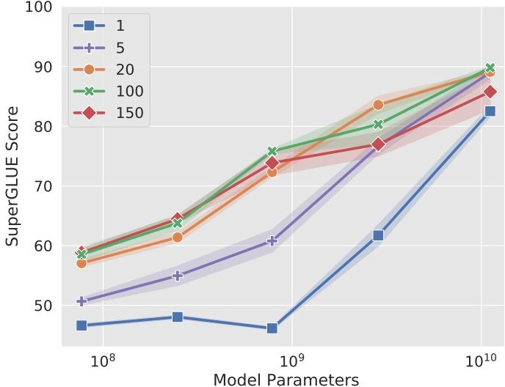
Prompt Tuning: Effect of Prompt Length
The shorter the prompt, the fewer new parameters must be tuned
Increasing prompt length is critical to achieving good performance
The largest model still gives strong results with a single-token prompt
Increasing beyond 20 tokens only yields marginal gains
[The Power of Scale for Parameter-Efficient Prompt Tuning. Lester et al. 2021]

Slide 91
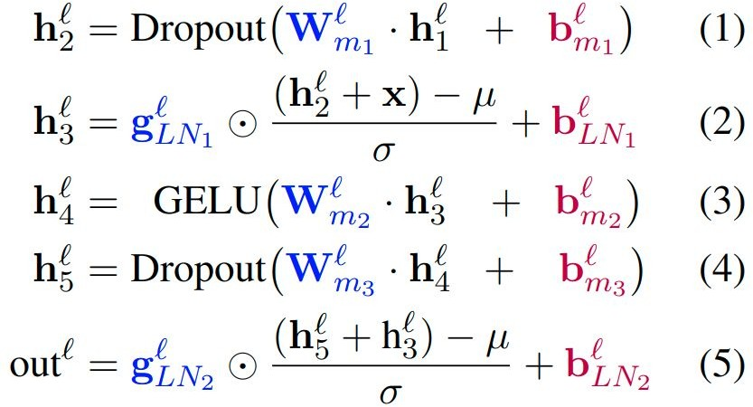
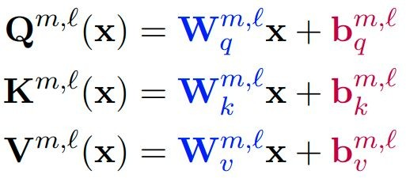
BitFit
120
BitFit adds bias terms in self-attention and MLP layers and tunes those.
[ “BitFit: Simple Parameter-eﬃcient Fine-tuning for Transformer-based Masked Language-models” Ben Zaken et al., 2021.]

Slide 92
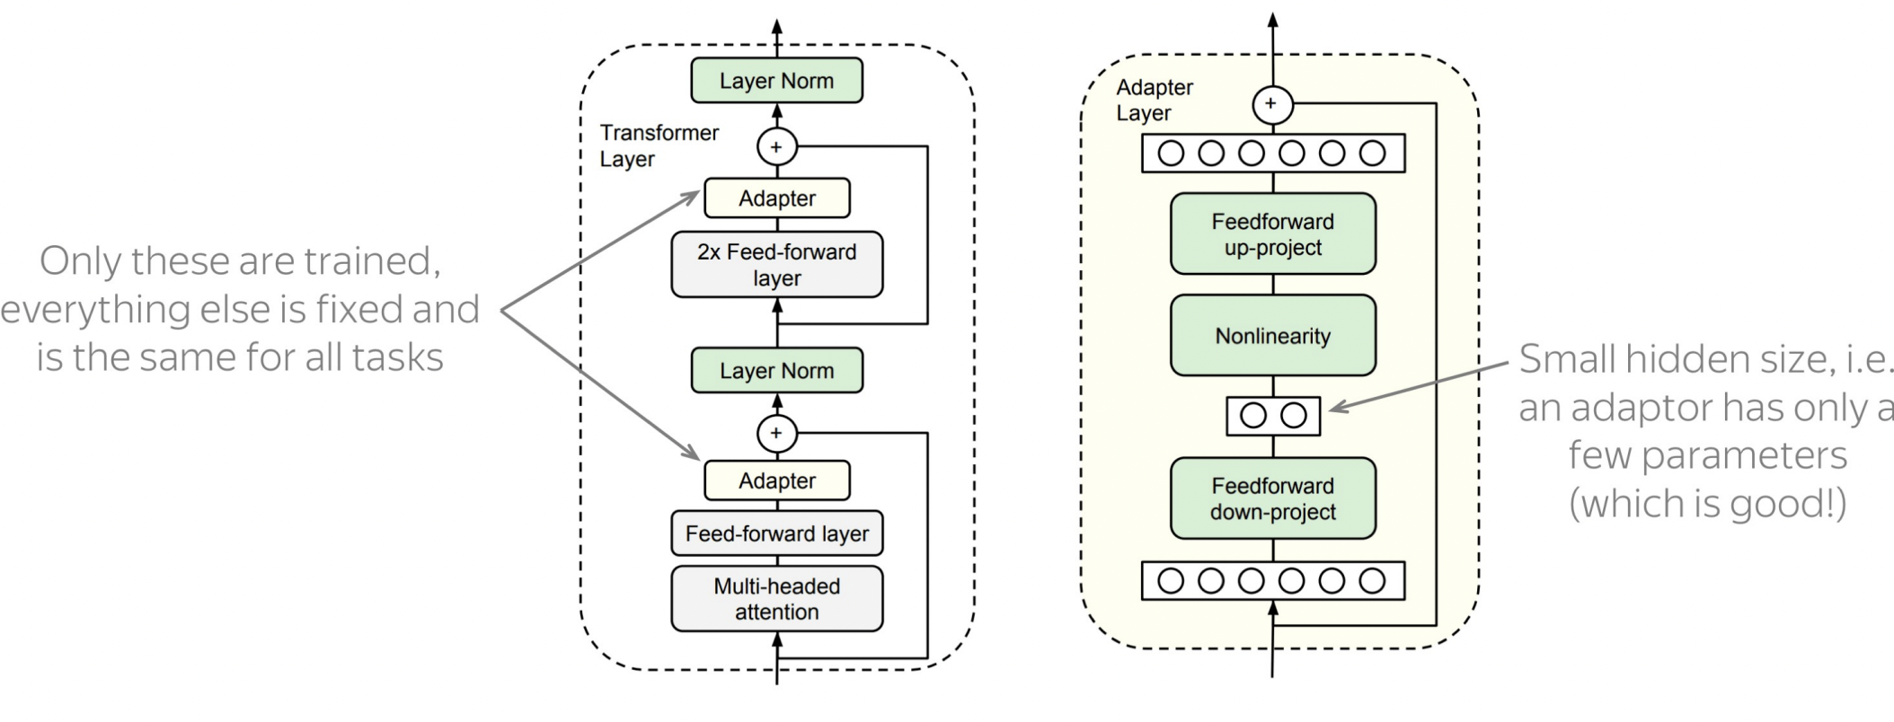
Adapters
Core idea: train small sub-networks and only tune those.
No need to store a full model for each task, only the adapter params.
[“Parameter-Eﬃcient Transfer Learning for NLP” Houlsby et al., 2019.]

Slide 93
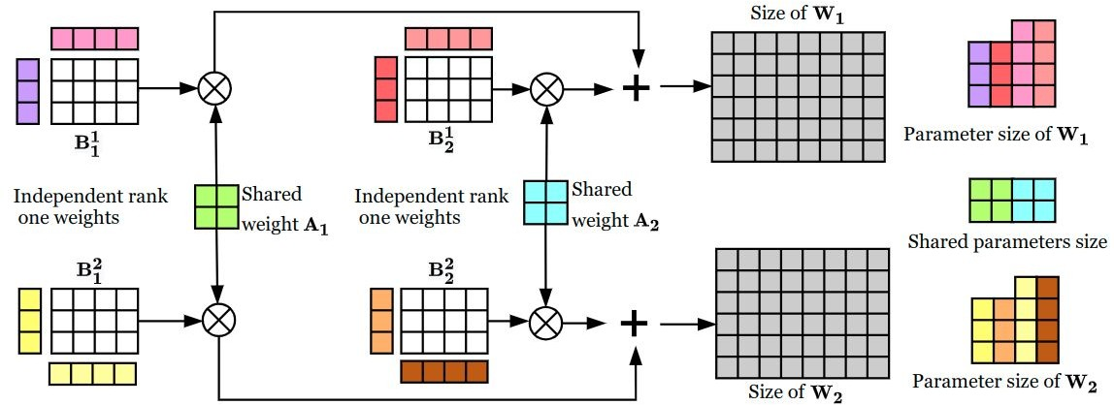
Compacter
123
Compacter layers modify Adapter layers to use low-rank parameterized hypercomplex multiplication (i.e., parameter eﬃcient W’s).
Mahabadi et al., 2021. "COMPACTER: Eﬃcient Low-Rank Hypercomplex Adapter Layers"
[ACL 2022 Tutorial Beltagy, Cohan, Logan IV, Min and Singh]

Slide 94
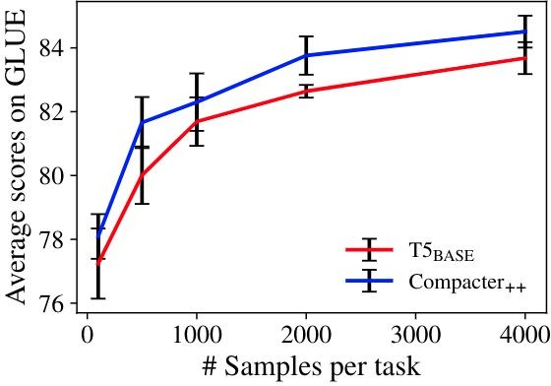
Compacter
124
Compacter layers modify Adapter layers to use low-rank parameterized hypercomplex multiplication (i.e., parameter eﬃcient W’s).
Mahabadi et al., 2021. "COMPACTER: Eﬃcient Low-Rank Hypercomplex Adapter Layers"
[ACL 2022 Tutorial Beltagy, Cohan, Logan IV, Min and Singh]

Slide 95
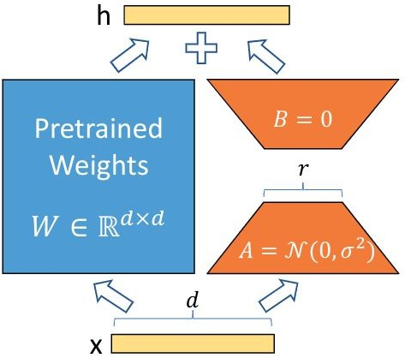
LoRa
125
Low rank additive updates to model weights.
W = W₀ + AB
Where the rank of A and B << min(d,h)
[“LoRA: Low-Rank Adaptation of Large Language Models” Hu et al., 2021.]

Slide 96
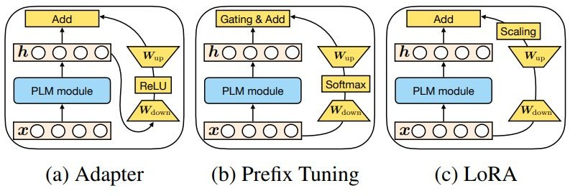
Towards a Uniﬁed View of Parameter-Eﬃcient Transfer Learning
Approaches are more similar than at ﬁrst glance.
He et al., 2022. "Towards a Uniﬁed View of Parameter-Eﬃcient Transfer Learning"
[ACL 2022 Tutorial Beltagy, Cohan, Logan IV, Min and Singh]

Slide 97
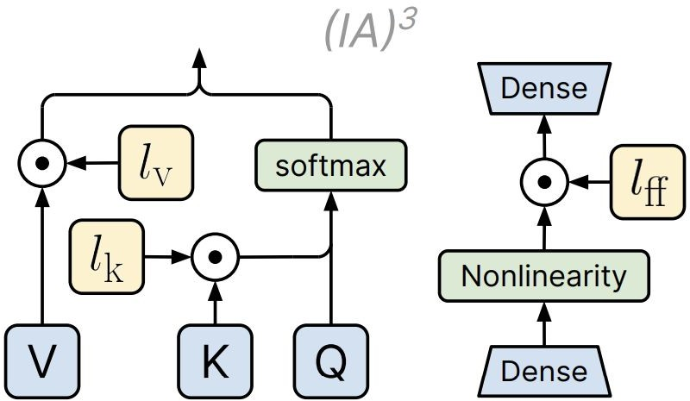
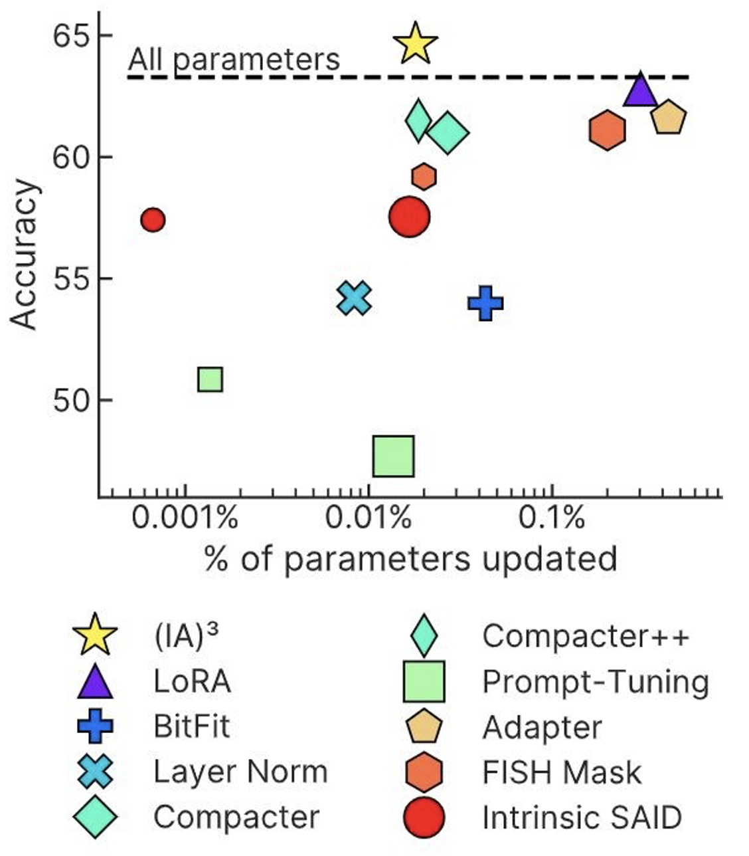
(IA)³ : Infused Adapter by Inhibiting and Amplifying Inner Activations
Element-wise rescaling of model activations with a learned vector:
keys and values in self-attention
feed-forward networks
["Few-Shot Parameter-Eﬃcient Fine-Tuning is Better and Cheaper than In-Context Learning" Liu et al., 2022.]

Slide 98

Prompt Tuning: Interpretability
Opposite goal: how unfaithful can their interpretation be of what they do?
Are continuous prompts interpretable?
Something related to sentiment analysis? 🤔
$p^{∗}$: optimized for the task
LM
Sentence: That was a great fantasy movie.
positive
["Prompt Waywardness: The Curious Case of Discretized Interpretation of Continuous Prompts" Khashabi et al., 2022.]

Slide 99
nearest-neighbor mapping of continuous prompt onto the word embeddings
definition of another task:
Write down the conclusion you can reach by combining the given Fact 1 and Fact 2.
$\tilde{p}$: optimized for the task + project to a given text
random sentence from web:
int clamp(int val, int min_val) { return std::max(min_val, val);
}
$p^{∗}$: optimized for the task
LM
Sentence: That was a great fantasy movie.
positive
["Prompt Waywardness: The Curious Case of Discretized Interpretation of Continuous Prompts" Khashabi et al., 2022.]
Notes:
Or a variety of random sentences we sampled from the web.
….
What do I mean by “projection”?
In our experiments we use nearest-neighbor projection of continuous prompt onto the word embeddings via dot product.
which is a commonly used in the field, for example, it is used in generative language models.

Slide 100
continuous prompts that
project to any given text
with tiny drop in task accuracy!
$\tilde{p}$: optimized for the task + project to a given text
$$\tilde{p}$$
91.8
$$Δ\sim 0.6\%$$
$p^{∗}$: optimized for the task
$p^{∗}$
92.4
accuracy
≈
40 60 80 100
accuracy
LM
Sentence: That was a great fantasy movie.
positive
["Prompt Waywardness: The Curious Case of Discretized Interpretation of Continuous Prompts" Khashabi et al., 2022.]
Notes:
In practice what we observe that, it is possible to find continuous prompts that project to a given text (≥ 94% token overlap with the given text) with tiny drop in task accuracy.

Slide 101
discrete (text) prompts: easy to interpret, but not easy to optimize
What is the sentiment of the following review? (positive or negative)
LM
Sentence: That was a great fantasy movie.
positive
continuous prompts:
unclear how to interpret, but easy to optimize
0.9 | 0.1 | -2.1 | 0.0
LM
Sentence: That was a great fantasy movie.
positive
["Prompt Waywardness: The Curious Case of Discretized Interpretation of Continuous Prompts" Khashabi et al., 2022.]
Notes:
... continuous prompts
Typically defined as a vector of real numbers prepended to the embedding of an input text to make the model generate a desired outcome.
For example, a continuous prompts that effectively solves the sentiment classification task.
Turns out that continuous prompts are complementary to their discrete counterparts:
We have algorithms for effectively optimizing them.
However, meaningful interpretation of continuous prompts as natural language is an open question problem.
(click) --- maybe this particular continuous prompt has something to do with sentiment analysis?? Unclear.
Motivated by this, we are interested in the research question of …
Motivated by the discrepancies between discrete and continuous prompts, we study focus continuous prompts and their interpretability.

Slide 102
Lots of good content here: https://docs.google.com/presentation/d/1seHOJ7B0bQEPJ3LBW5VmruMCILiVRoPb8nmU2OS-Eqc/edit#slide=id.p

Slide 103
Open questions & future work
Parameter efficient optimization — optimize fewer parameters than the whole model.
Space efficiency — fewer parameters to store
Computation efficiency? A bit unclear
Their interpretability is not quite clear.
Open research question: How to bridge the gap between continuous prompts vs discrete prompts?

Slide 105
Mor's analysis:
https://docs.google.com/presentation/d/1hvo-MtkikdLhBOzGwb5W7gi3edoiLCSFcKhgRqdz26A/edit#slide=id.g188e6835ab6_0_63

Slide 106
https://arxiv.org/pdf/2112.07916.pdf

